Slide 1

CISM 190: Intro to Tech
March 2017
Week 2

Slide 2
The Internet of Things (IoT) discussion
What is the internet of things?
Why is the IoT important?
What is an industry that the IoT might impact? How?
Who will profit from the IoT?
What could be some negative impacts or risks of the IoT?

Slide 3
Recap of Last Week’s Topics
What is computer programming?
What is the difference between hardware & software?
What is a programming language?
What happens behind the scenes when you visit a website?
What is an IP address?
What is the difference between client and server?

Slide 4
Lecture outline
Overview of tech roles (e.g. dev, design, PM)
Tech industry working arrangements
Getting a job in tech

Slide 5
Overview of Tech Roles

Slide 6
What is a software developer?
Software developer: Someone that uses one or more programming languages to build software
Also often called a “dev”, programmer or software engineer
Some different types of developers:
Web developer (front-end, back-end, full stack)
Applications developer (can include web developers)
Systems software developer
Notes:
Project manager – lindsey
Dev, devops, dev in test - mikey
Ui, UX, - mikey

Slide 7
What is a designer (in software)?
Designer: Someone that envisions and creates the look and feel of software
Design is VERY broad! Includes visual & interactive elements
Some different types of designers:
User Experience (UX)
User interface (UI)
Web designer
Notes:
Project manager – lindsey
Dev, devops, dev in test - mikey
Ui, UX, - mikey

Slide 8
What is a product/program manager (PM)?
Product manager: responsible for orchestrating the various activities associated with ensuring that a product is delivered that meets users' needs.
Helps design, development, and marketing work together to deliver a product on time & on spec
Sometimes considered the “CEO” of a product – does whatever needs to be done!
Notes:
Project manager – lindsey
Dev, devops, dev in test - mikey
Ui, UX, - mikey

Slide 9
Example Software Developer JD - Expedia
Responsibilities:
You will design and implement software applications for our lodging systems and detect/alert anomalies.
You will collaborate with product managers and other engineering teams to prototype creative solutions quickly and implement the technical vision.
Engineer innovative solution with modern technologies to improve platform performance
Drive continuous improvement in our software development process within an agile development team.
You will write automated unit, system and acceptance tests as to support our continuous integration pipelines.
Qualifications:
1+ years overall development experience with demonstrated growth in producing web
Able to present technical information in a clear and concise manner.
Strong technical proficiency in programming languages, JavaScript/HTML/CSS
Clean technical designs are part of your DNA and you have the ability to instill the same drive in others.
Critical thinking: there are always options; you will be adept at identifying them, evaluating options and concisely communicate them to your peers.
Experience in agile/Scrum software development practices and a track record of learning from your actions to make positive adjustments.
BS Degree in Computer Science or equivalent work experience.

Slide 10
Example Software Developer JD - Nordstrom
Key Responsibilities:
• Provision, maintain, and iterate on a common data pipeline
• Gather, store, and process raw data at scale
• Collaborate with software developers and data scientists to serve their data monitoring and analytic needs
• Make decisions based on metrics and measurable data
• Adjust positively to quickly changing priorities and shifting goals
• Automate yourself out of a job
Qualifications:
· Degree in Computer Science or equivalent experience
· Agile software development experience
· Excellent problem solving, debugging and troubleshooting skills
· Familiarity with Linux, cloud computing (i.e., AWS), and container technology (i.e., Docker, Kubernetes)
· Fluency with at least one of Java, Go, Python, NodeJS, or other modern language stack
· Experience with tools that promote Infrastructure-as-code (i.e., Cloudformation, Terraform, Chef, Ansible)
· Interest in analytics and streaming platforms (i.e., ElasticSearch, Kafka, Spark, Hadoop, etc) is a big plus

Slide 11
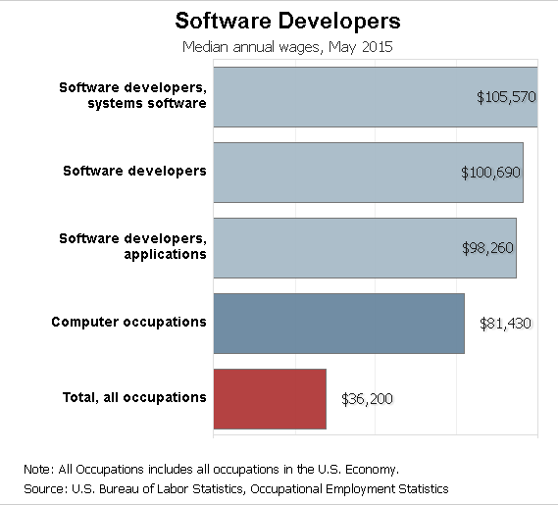
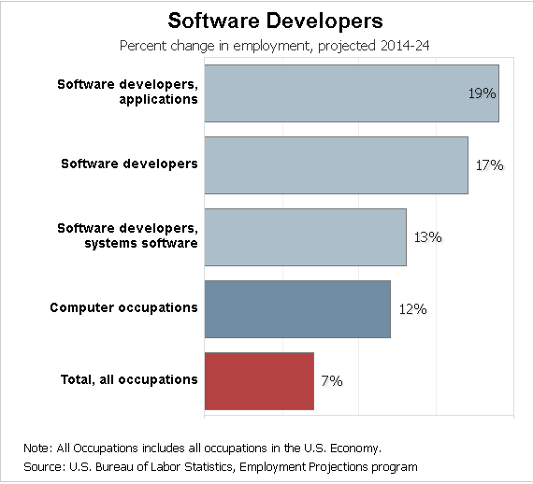
Software developer job growth & pay
Note: Wage data is MEDIAN – including experienced developers! Expect to make much less as entry level

Slide 12
Two main working arrangements
Working for a company
Working for yourself
Pros:
Focus on coding, not the other stuff
Structure, support, and mentorship are easier to find
Stable income: you know how much money you will make, usually great benefits included
Built in networking
Social proof of your ability
Cons:
Potential for conflict when learning new culture, norms, expectations
Commuting/the grind
(Potentially) less upside in earning potential
More restrictions on people with records
Pros:
Can be really rewarding to build your own thing (even if it fails)
Potentially higher payoff (professionally and financially)
You will learn how to do a lot more than coding
Freedom in building your own schedule, network, commute, culture, etc.
Cons:
Income instability
Emotionally draining
Requires skill in a lot of areas outside of coding
Can be isolating
For startups – very high likelihood of failure

Slide 13
I want to work for a company… but which one?
You know a lot of these:
Google
Facebook
Microsoft (mostly)
Maybe less well known:
Accenture
Wipro
Deloitte
Big Company
Startups mostly begin here! Some Seattle based ones:
EnergySavvy
Socrata
Textio
Freelancers, agencies, etc. Some are in Unloop’s network
Substantial
FuseIQ
Loxley Digital
Small Company
Product
Service

Slide 14
I want to work for myself… but how?
Freelance
Cross between working for others & working for yourself
Find clients, keep them happy, get paid
Requires a depth and breadth of skill not required in a company
Upshot: can be crafted to suit your lifestyle, solo or through an agency
Entrepreneurship
The riskiest option – should you quit your day job?
But arguably the biggest upside financially, professionally, and personally
Really, really hard – the average entrepreneur fails 7 times before succeeding
A mythological force in the tech industry – a lot of people build towards this

Slide 15
Working arrangement recap
What are the pros and cons of working for a big company vs. a startup?
Why do so many people want to do a startup if so many fail?
What option makes the most sense for you?

Slide 16
How do I know if Tech is right for me?
Enjoy solving puzzles?
Love the feeling of satisfaction you get from building something?
When you see a cool new thing (e.g. a magic trick, radio, motion sensor light), do you want to find out how it works?
Notes:
mikey

Slide 17
What interests, passions, and skills help people succeed in tech/CS?
Curiosity
Hard Work
Teamwork
Logical Thinking
Patience
Empathy
Notes:
mikey

Slide 18
Can I get a job with a background?
Yes – people do it, even if it isn’t easy
The stigma you will face is real
In our conversations with employers, what they expect regarding criminal record:
Honesty – be upfront
Context/circumstance about the crime
Accepting responsibility
Evidence of significant progress & a new direction
Some questions to think about:
How can you demonstrate that an employer can trust you?
What strengths has your experience in prison given you that would be an asset to an employer?
Notes:
LW

Slide 19
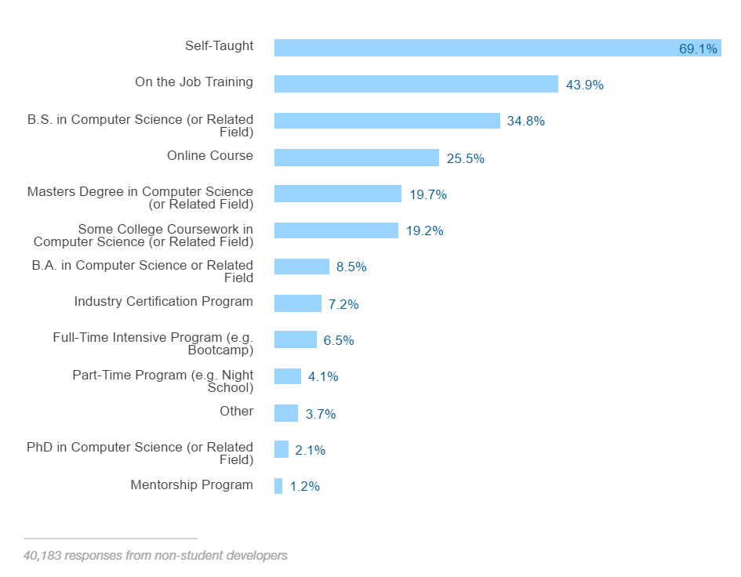
What are my education options for CS?
Regardless of path of study, skills and ability to “do the job” trumps educational pathway
Bootcamp
Community College
Four-year degree
Self-study (Free!)
Developer Education Today
Notes:
Cost, time
Lindsey – Bootcamp, Community College, 4-year
Ben – self-study

Slide 20
How to get hired?
Develop clear goals about where you want to go
Build things, all the time, and show them publicly
Meet people, build relationships and ask for advice
Degrees and certifications: they don’t hurt
Though everything, be curious about how things work
Notes:
mikey

Slide 21
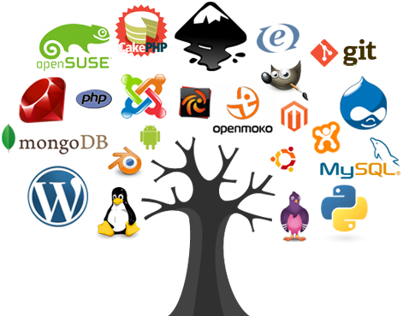
How do I demonstrate my skills?
Portfolio: what goes in it?
Personal projects
Open source contributions
How to make your portfolio public
Make a website with your best work
Put your code on GitHub
Technical Interviews
Notes:
mikey

Slide 22

Build relationships in the Tech Community
What connections do you need?
Employers, Mentors, Community
How do you get them?
Go to meetups and events
Research and reach out
Open Source contributions
Notes:
Lindsey

Slide 23
Basic Programming Concepts review
What is an if statement?
What is a for loop?
What is a while loop?
How does a nested if statement work?

Slide 24
Variable
So far, we’ve talked about code based on reacting to “in the moment” conditions. But robots (and programs) can store data, and use that to help them to decide what to do.
A variable is a value that can change, depending on conditions or on information passed to the program. This variable can then be used in programs. Variables store different types of data, below are three common types:
String - A string variable is a string of alphanumeric characters and allowed symbols that are contained within quotation marks. For example, "Hello world, I'm 102 years old today!" is an example of a string. Strings are basically used for storing text.
Number - A number variable couldn't be more straightforward because all number variables store are numbers. You don't store them within quotes like strings, instead, numbers can just be written as they are. If you want to store the number 9 in a variable, you just write 9. Today we will only be using numerical variables.
Boolean - A boolean variable is one of two things: true or false. This data type is kind of like an on and off switch, so you can ask true or false questions in your code. For example, you might ask "is the video currently playing?" The response you'd get would be a boolean variable. True would mean the video is currently playing and false would mean it is not.

Slide 25
Variable
These variables allow us to 'save' the values from our coding, in order to write more complex code. We do this by defining a variable with a specific, case-sensitive name. Once you create (or declare) a variable as having a particular name, you can then call up that value by typing the variable name.
First step, name your variable. Name should be:
Meaningful (distancetotheobstacleonleft)
Short (distleftobstacle)
Readable (DistLeftObstacle)
Set a value for your variable.
DistLeftObstacle = 100
Adjust and use value for your variable
DistLeftObstacle = DistLeftObstacle + 100
If DistLeftObstacle is less than DistRightObstacle, turn right. Otherwise turn left.

